Slide 1
TERMS AND CONDITIONS
These PowerPoint slides are a tool for lecturers, and as such:
YOU MAY add content to the slides, delete content from the slides, print out the slides, and save the slides onto your computer or server.
YOU MAY NOT resell, reproduce or redistribute the content in any form whatsoever, without prior written permission from the copyright holder.
© Troupant Publishers (Pty) Ltd, 2016
Selected images used under licence from Shutterstock.com

Slide 2
Engineering Systems
NQF Level 2

Slide 3
Maintaining engineering systems
Module 10

Slide 4
Identifying consumables needed to maintain engineering systems
Unit 10.1

Slide 5
Defining consumables
Consumables are substances that are used up when operating and maintaining an engineering system.
E.g. fluids (gases and liquids) and lubricants (oils or grease).

Slide 6
Commonly used lubricants and fluids
Diesel oil.
Engine oil.
Gear oil.
Grease.
Antifreeze.
Brake fluid.
Automatic transmission fluid.
Paraffin.
Solvents.
Water.

Slide 7
Commonly used lubricants and fluids
Figure 10.2 A gearbox
Figure 10.3 Grease used on a roller chain

Slide 8
Other consumables
Filters.
Locking devices.
Gaskets and gasket sealers.
Gloves.
Rags.

Slide 9
Filters
Used to remove substances such as water or dust from a system.
Types include:
Air filters.
Oil filters.
Fuel filters.

Slide 10
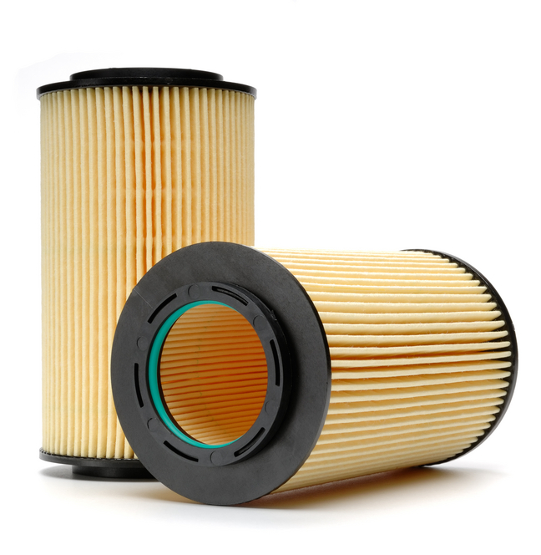
Filters
Figure 10.4 An air filter
Figure 10.5 An oil filter

Slide 11
Filters
Figure 10.6 A fuel filter

Slide 12
VIDEO: Filters

Slide 13
Locking devices
Vibration may cause nuts and bolts or other fasteners to loosen.
Types include:
Epoxy and adhesives.
Spring washers.
Star washers.
Tab washers.
Locknuts.
Castle nuts.
Self-locking nuts.
Circlips.
O-rings.
Gaskets and gasket sealers.

Slide 14
Locking devices
Figure 10.7 Nuts and bolts

Slide 15
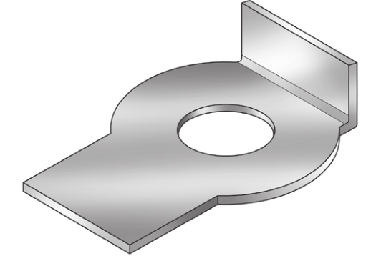
Locking devices
Figure 10.9 Star washers with
internal teeth
Figure 10.8 A spring washer
Figure 10.10 A tab washer

Slide 16
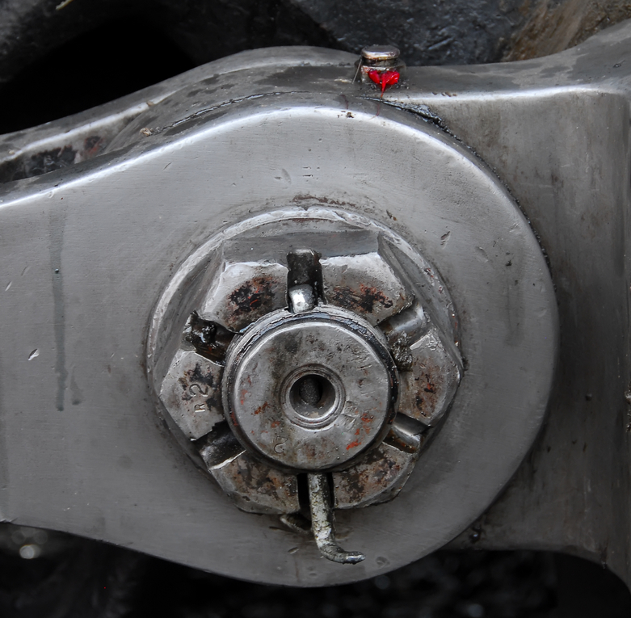
Castle nuts
Figure 10.12 A castle nut with split pin
Figure 10.11 A locknut

Slide 17
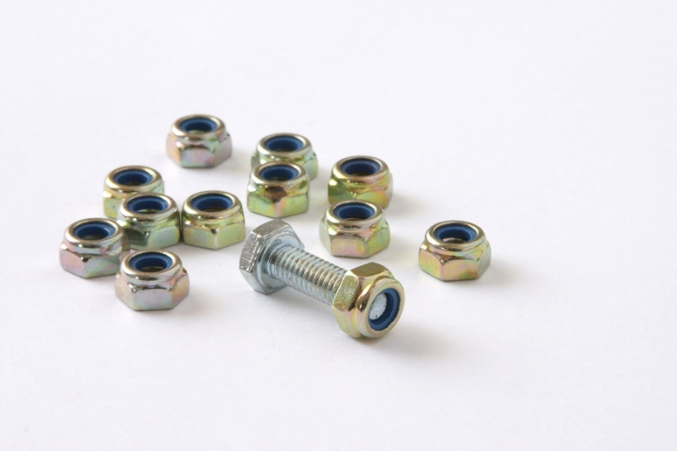
Self-locking nuts
The two most common types of self-locking nuts are:
The all-metal locknut.
The fibre or nylon locknut (‘Nyloc’ nut).
Figure 10.13 A fibre or nylon locknut

Slide 18
O-rings
Figure 10.14 O-rings

Slide 19
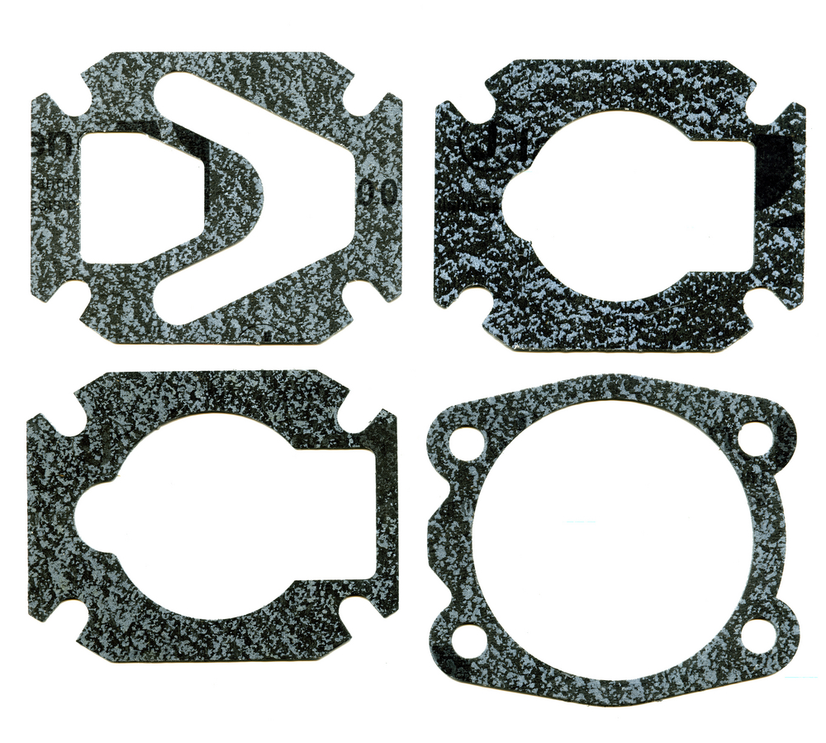
Gaskets and gasket sealers
Gaskets
Figure 10.15 Gaskets

Slide 20
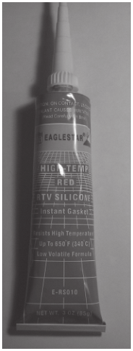
Gaskets and gasket sealers
Gasket sealers
Figure 10.16 Gasket sealer

Slide 21
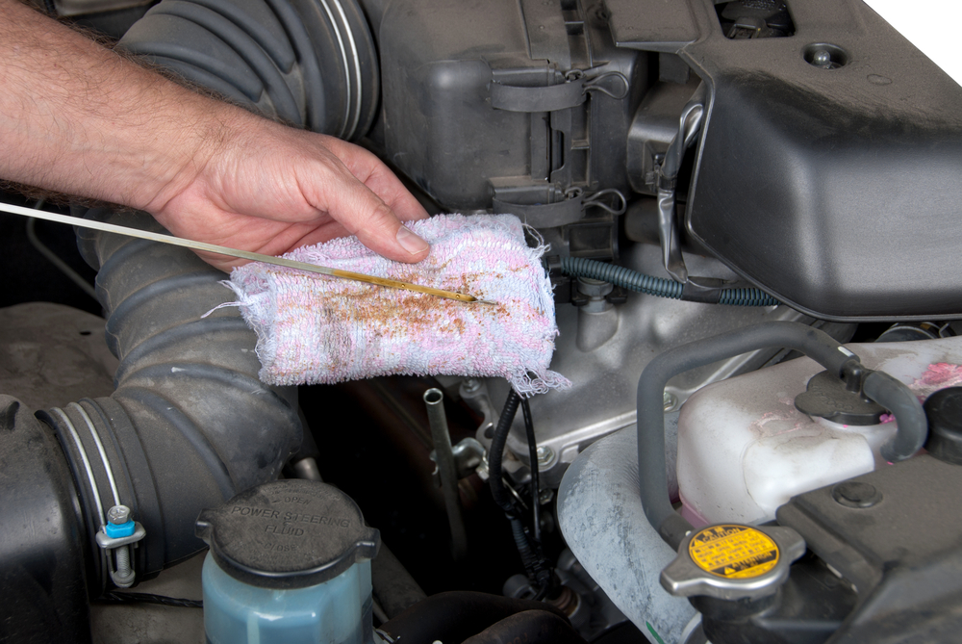
Disposable gloves and rags
Figure 10.18 Cleaning the dipstick
Figure 10.17 Wearing disposable
gloves to protect hands

Slide 22
Caring for engineering systems
Unit 10.2

Slide 23
Manufacturers’ manuals
Mechanics and technicians use manufacturers’ manuals as aids to provide efficient and effective service and maintenance.
Available for quick and easy reference.

Slide 24
Manufacturers’ manuals
Includes procedures for:
Maintenance.
Disassembling.
Reassembling.
Inspection and adjustment of components.
Diagnostics for troubleshooting.

Slide 25
How to use a manual
Preparation lists the special service tools (SSTs) needed.
Repair procedure starts with an overview illustration showing different components and how they fit together.

Slide 26
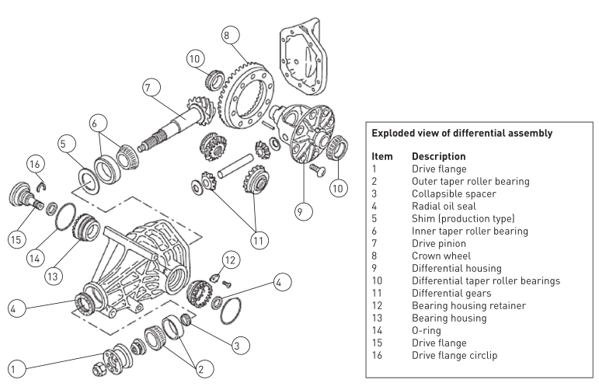
How to use a manual
Figure 10.20 An example of an overview illustration of a car differential assembly

Slide 27
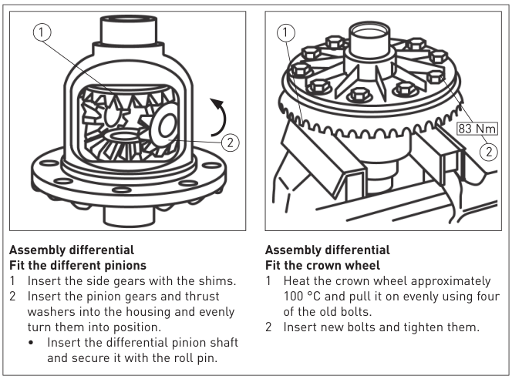
How to use a manual
Figure 10.21 An example of a differential assembly procedure

Slide 28
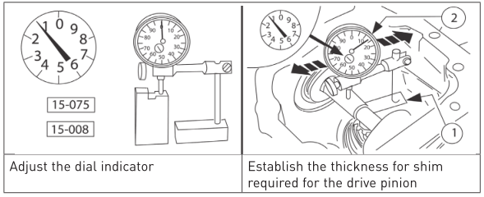
How to use a manual
Figure 10.22 Adjusting the dial indicator and measuring the thickness of the shim

Slide 29
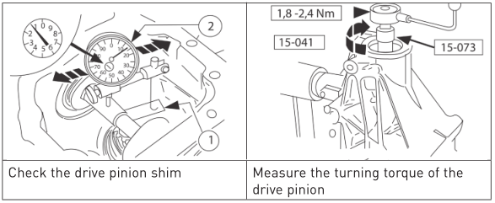
How to use a manual
Figure 10.22 Adjusting the dial indicator and measuring the thickness of the shim

Slide 30
Bearings
A bearing is a device in a machine that allows two parts to rotate or move in contact with each other with reduced friction.
Types include:
Ball bearings.
Tapered roller bearings.
Cylindrical roller bearings.
Needle roller bearings.
Sleeve bearings.
Thrust bearings.

Slide 31
Bearings
Ball bearings
Figure 10.24 A ball bearing

Slide 32
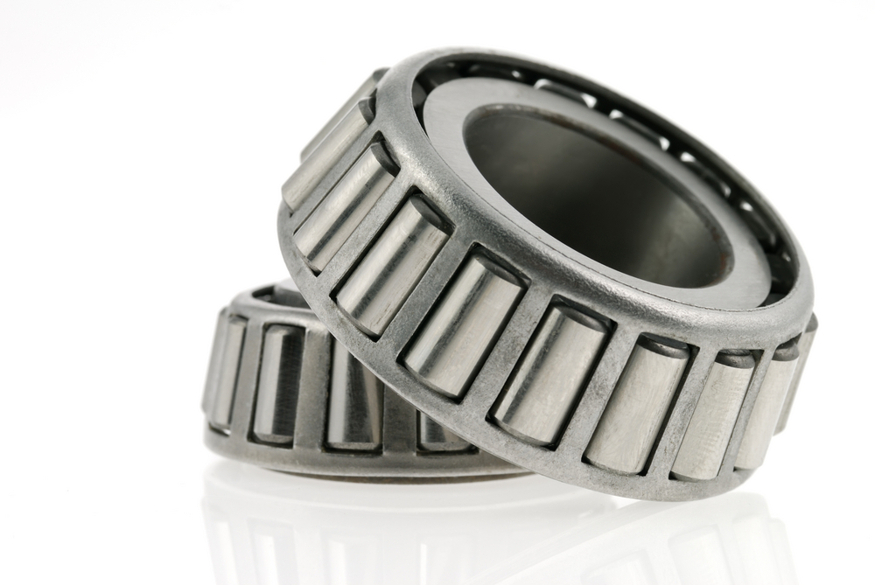
Bearings
Tapered roller
bearings
Figure 10.25 Tapered roller bearings

Slide 33
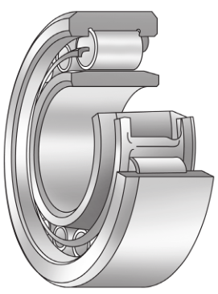
Bearings
Cylindrical
roller bearings
Figure 10.26 Cylindrical roller bearings

Slide 34
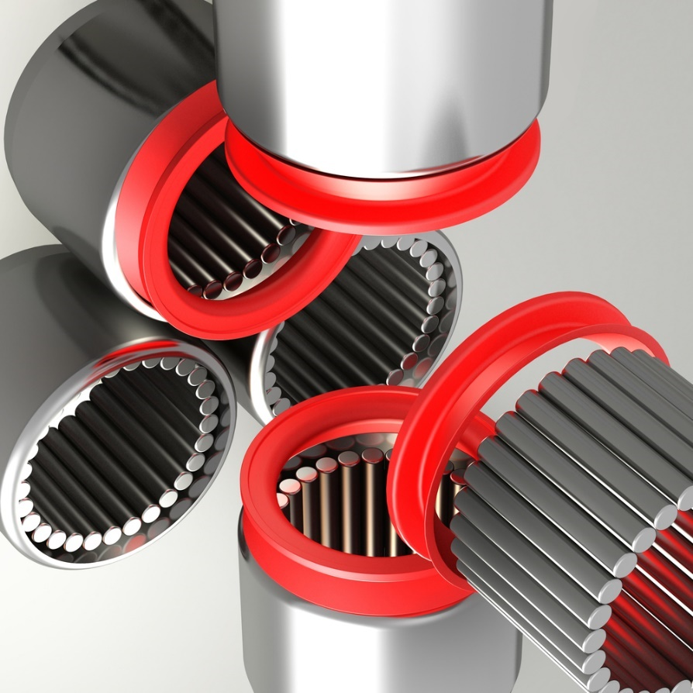
Bearings
Needle
roller bearings
Figure 10.27 Needle roller bearings

Slide 35
Bearings
Sleeve
bearings
Figure 10.28 A sleeve bearing

Slide 36
Bearings
Thrust
ball bearings
Figure 10.29 Thrust ball bearings

Slide 37
Bearing life
The following factors affect bearing life:
Temperature.
Lubrication.
Improper care in mounting, resulting in contamination, misalignment and deformation.

Slide 38
Care of bearings
Cleaning guidelines
Always work in a clean environment.
Do not use the same container for the cleaning and the final rinsing of bearings.
Do not use cotton waste or dirty cloths to wipe bearings – rather use lint-free rags.
Do not expose bearings to moisture.
Do not remove grease or oil from new bearings.
Always use the lubricant recommended by the manufacturer.

Slide 39
Care of bearings
Figure 10.30 Cleaning of bearings

Slide 40
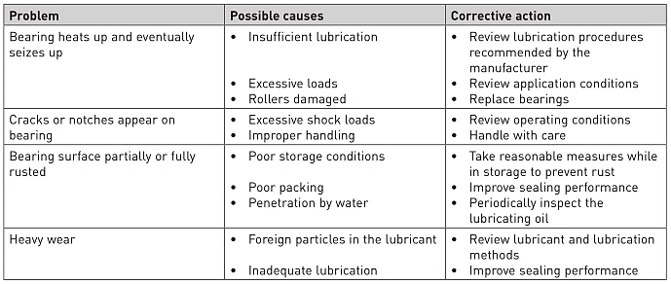
Care of bearings
Table 10.1 Bearing repair chart

Slide 41
Methods used to replace bearings
Figure 10.31 Using an arbour press

Slide 42
Methods used to replace bearings
Figure 10.32 Using mechanical jaw-type pullers
Figure 10.33 Using a slide hammer puller

Slide 43
Power cables
Power tools have a main power cable that connects to the socket outlet by means of a plug.
Most common cables:
Two-core cables.
Three-core cables (for devices requiring an earth).

Slide 44
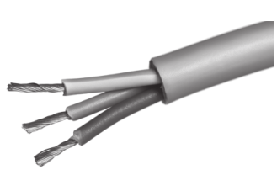
Power cables
Figure 10.35 A multistrand conductor

Slide 45
Power cable guidelines
Check extension leads regularly.
Check the size of a damaged cable when replacing it.
Store the cable neatly.
Attend to damaged or frayed cables before using equipment.
Do not place extension leads or cables under carpets.

Slide 46
Power cable guidelines
Do not extend power cables haphazardly. Ensure that plugs are easily identified with the equipment they control.
Do not use power cables with wet hands.
Before cleaning cables, ensure the power supply is switched off and the plug removed from the socket.
When stripping insulation from a power cable, avoid cutting the conductor strands. If you cut any strands by mistake, restrip the insulation.

Slide 47
Power cable guidelines
When terminating a cable, ensure that the insulation is maintained up to the terminal and that there are no stray or loose strands of wire.
If a cable clamp is provided, make sure that you use it and that it is screwed tightly enough to prevent the cord outer sheathing from being pulled back outside the casing.

Slide 48
Maintenance and care of portable drilling machines
Figure 10.38 Opening the drilling machine

Slide 49
Maintenance and care of portable drilling machines
Figure 10.39 Top cover removed
Figure 10.40 Using a paintbrush
to remove dust

Slide 50
Maintenance and care of portable drilling machines
Figure 10.41 Checking for
excessive play
Figure 10.42 Checking the gears

Slide 51
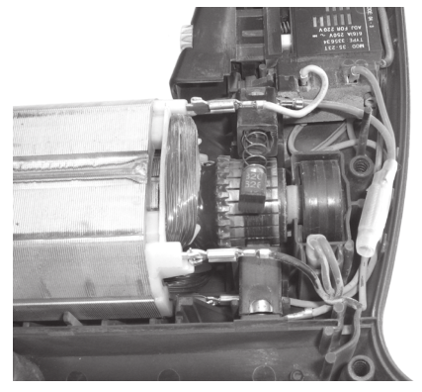
Maintenance and care of portable drilling machines
Checking
the brushes
Figure 10.43 Checking a brush

Slide 52
Summative assessment
Test your knowledge of this section by completing the Summative assessment (page 170 of your Student’s Book)

